Slide 1

Advanced x86: BIOS and System Management Mode Internals Boot Process
Xeno Kovah && Corey Kallenberg
LegbaCore, LLC

Slide 2
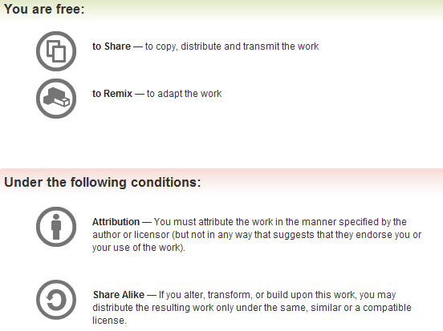
All materials are licensed under a Creative Commons “Share Alike” license.
http://creativecommons.org/licenses/by-sa/3.0/
Attribution condition: You must indicate that derivative work
"Is derived from John Butterworth & Xeno Kovah’s ’Advanced Intel x86: BIOS and SMM’ class posted at http://opensecuritytraining.info/IntroBIOS.html”
Notes:
Attribution condition: You must indicate that derivative work
"Is derived from John Butterworth & Xeno Kovah’s ’Advanced Intel x86: BIOS and SMM’ class posted at http://opensecuritytraining.info/IntroBIOS.html”

Slide 3
This covers an example of a minimal BIOS boot process, just to give an idea of what the BIOS does before your operating system starts to load.
It doesn’t include everything of course because it’s geared towards minimal-configuration to achieve 100% functionality.

Slide 4
Boot Process at a glance*
Power-up
16-bit Real Mode accessing address FFFF_FFF0h
Operating mode selection
Flat protected mode
Preparation for memory initialization
CPU microcode update
Set up CPU Cache as RAM (CAR)
Chipset initialization (MCHBAR, PCIEXBAR, etc.)
Memory initialization
Configure the memory controller
Post memory initialization
Memory test
Copy firmware from flash to memory for faster execution*
In the doc this is listed as firmware shadowing but I’m modifying it somewhat since the BIOS can perform the copying of flash components to memory
As a general rule, it’s better to copy things to memory before execution as soon as possible
Memory transaction redirection (PAM registers)
Setting up the stack (before memory initialization, stack will be in CPU cache)
Transfer to DRAM (the BIOS flash that was copied to memory is now executed)
*This list composed from Intel Minimal Architecture Boot Loader
Notes:
Acronyms not yet defined:
PAM = Programmable Attribute Map

Slide 5
Boot Process at a glance*
Miscellaneous platform enabling
Platform dependent: Initialize clocks to operate at N Hz, configure general-purpose I/O, etc.
Interrupt enabling - PIC (Programmable Interrupt Controller), LAPIC (Local Advanced PIC), I/O APIC, etc.
Interrupt tables
Interrupt Vector Table (IVT)
Interrupt Service Routine (ISR) – INT 10h, etc…
Interrupt Descriptor Table (IDT)
Exceptions
Setting up timers
In ICH: RTC (, HPET, 8254 Programmable Interrupt Timer (PIT), TCO timer (used as watchdog)
In CPU: LAPIC timer
Memory caching control
Processor discovery and initialization
CPUID
Startup Inter-Processor Interrupts (SIPIs) are written to a processor’s LAPIC telling it to wake up and where to start executing code at (must be a 4KB aligned boundary)
Intel SW Programmer’s Guide has more detail on this
Each processor will awaken in Real Mode
*This list composed from Intel Minimal Architecture Boot Loader
Notes:
Acronyms not yet defined:
RTC = Real Time Cock
HPET = High Performance Event Timer
TCO = "In this document the acronym TCO (Total Cost of Ownership) refer to a logic block in the Intel ICH products family. The Watchdog Timer (WDT) is one of the functions of that logic block."

Slide 6
Boot Process at a glance*
I/O devices
Super I/O can control PS/2 keyboard, serial, parallel, etc. interfaces
PCI device discovery
Enumerate PCI devices
Assign address space (port IO, Memory Mapped IO)
Detect and execute Expansion ROMs (XROMs)
Memory map
Region types
Memory
Reserved
ACPI Reclaim
ACPI NVS
ROM
IOAPIC
LAPIC
Region locations
Consult your datasheet for a complete list, but we’ll cover some of the more relevant ones
Non-Volatile (NV) storage
CMOS
NV SPI flash
Handoff to boot-loader
*This list composed from Intel Minimal Architecture Boot Loader

Slide 7
Only 16 steps? BIOS is simple!
Easy to summarize, not so easy to implement
Very complex implementations
Even if it’s only a couple MB, it’s a very DENSE couple of MB
That list taken from the Intel Minimal Architecture Boot Loader which provides a pretty good list of functional requirements
What is left out is:
Initializing SMM and locking down SMRAM
Locking down the BIOS Flash
*This list composed from Intel Minimal Architecture Boot Loader

Slide 8
How do you learn about all that stuff?
You could go review open source BIOSes’ code (CoreBoot or UEFI’s TianoCore reference code)
Or you can sign an NDA with Intel and read their very large “BIOS Writer’s Guide” and associated documentation for each CPU/chipset
At the end of the day, the open source code is more or less just doing what they’re told to do by the Intel documentation

